Slide 1
Implementing Remote networks using OpenVPN for ROS applications

Slide 2
Index
기본 용어 정리(개인용)
Port Forwarding
VPN & open VPN
Cloud-Base Solution VS PortForwarding

Slide 3
Router
LAN local area network
Wide area network WAN
Gate away address = IP for Router
Public IP address = Ip connected to Router address
Private Ip address
IPv4 192~ private

Slide 4
Network Address Translation
Ex) smart phone(client) -> Wikipedia(server)
remember that request is from smart phone private IP address in router
2. change private IP of smart phone to public IP address

Slide 5
Port Forwarding
Port?
하나의 컴퓨터에 server 여러 개
How to identify? – use port num
0-1023 well known port
Setting tunnel for
Public IP + port num -> private IP + port num

Slide 6
Cloud-Base vs PF
 | Cloud-based solution | PortForwarding
Advantage |  | -Multidirectional -No middle point or 3rd party solution -Due to Ros-Ros channel, need not to consider all message types
Challenges | -Non-Ros development is needed -Consideration for all types of message is needed -Still need to learn tools -Concern over security | -multilayered process (complicated settings) -Requires knowledge of IP address (IP is dynamically changed - > automatically update PF settings whenever IP is changed) -Requires permission -VPN could not be implemented -> use mobile VPN

Slide 8
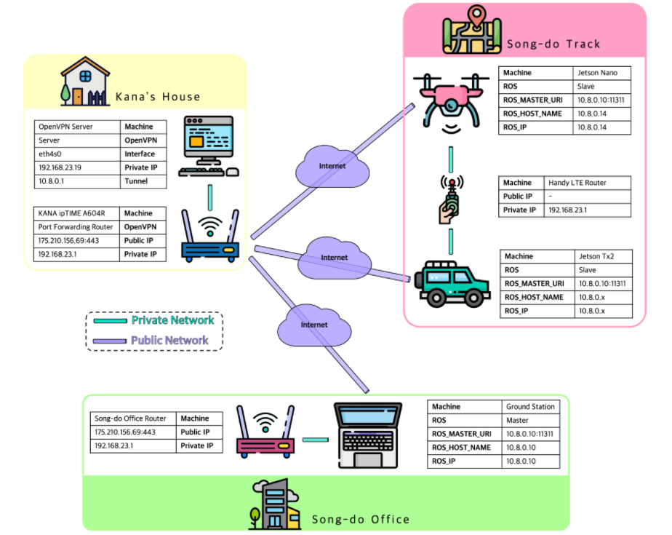
Open VPN on ROS
Open VPN 서버에 클라이언트로서 접속되는 PC
(Internet connected also)
이 PC가 ROS devices 들의 Master 역할
Client
OpenVPN connection
Open VPN 서버 운영되는 PC
Internet
ROS devices는 인터넷을 통해 OpenVPN 서버의 클라이언트?? (ROS_MASTER_URI)PC와 통신 OpenVPN서버를 통해 Master와 통신

